Slide 1
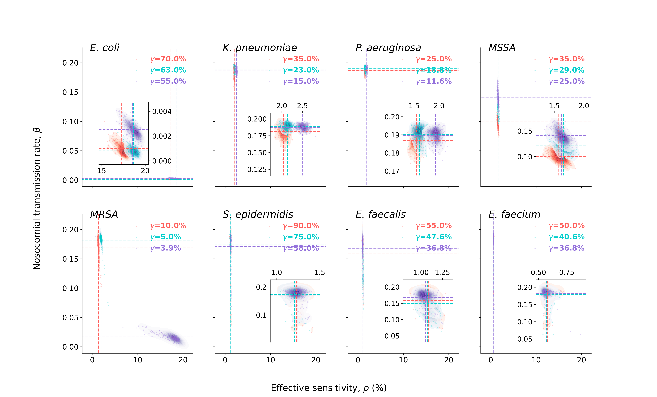
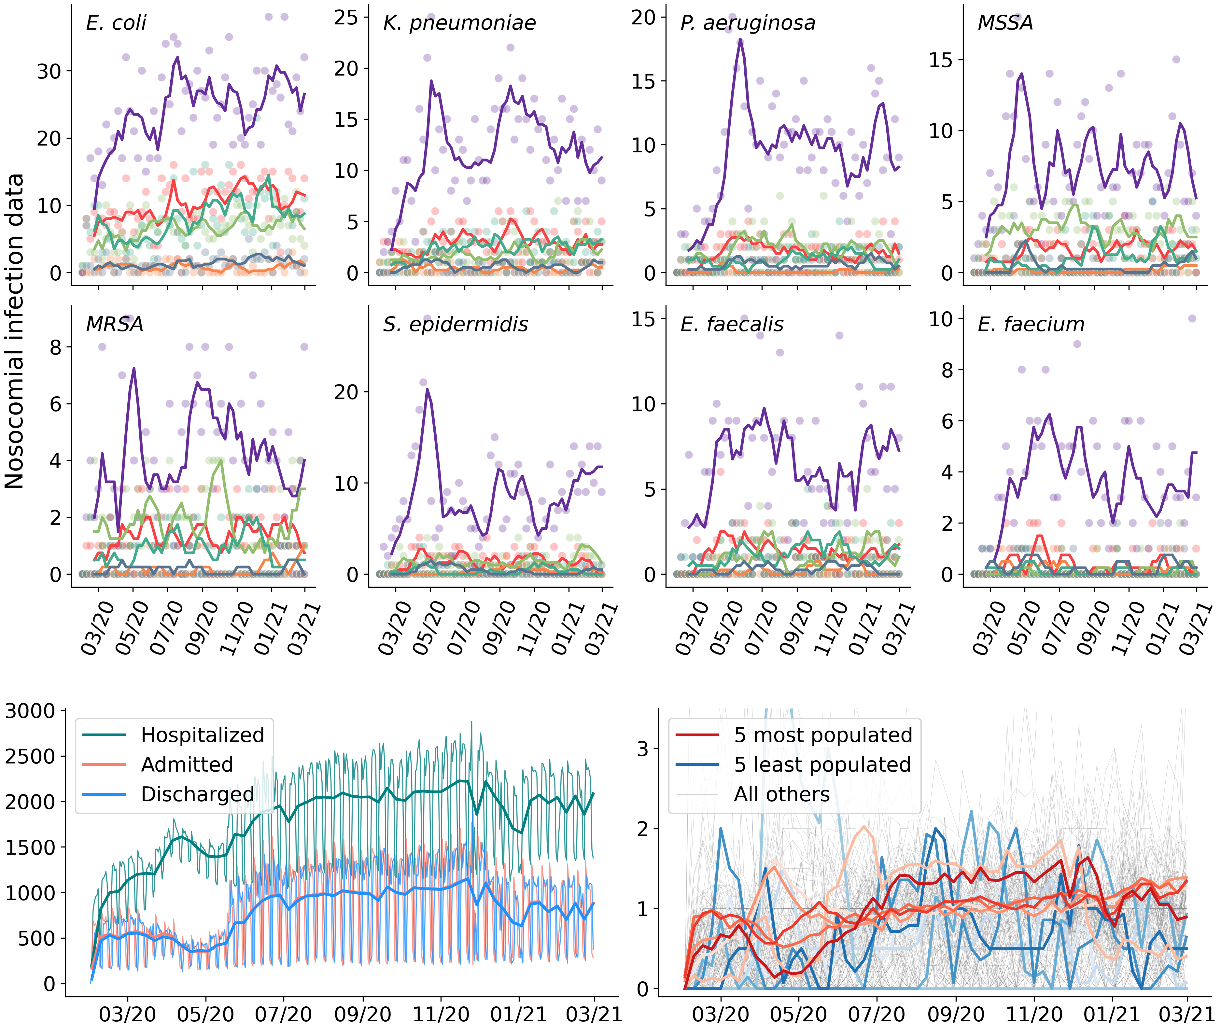
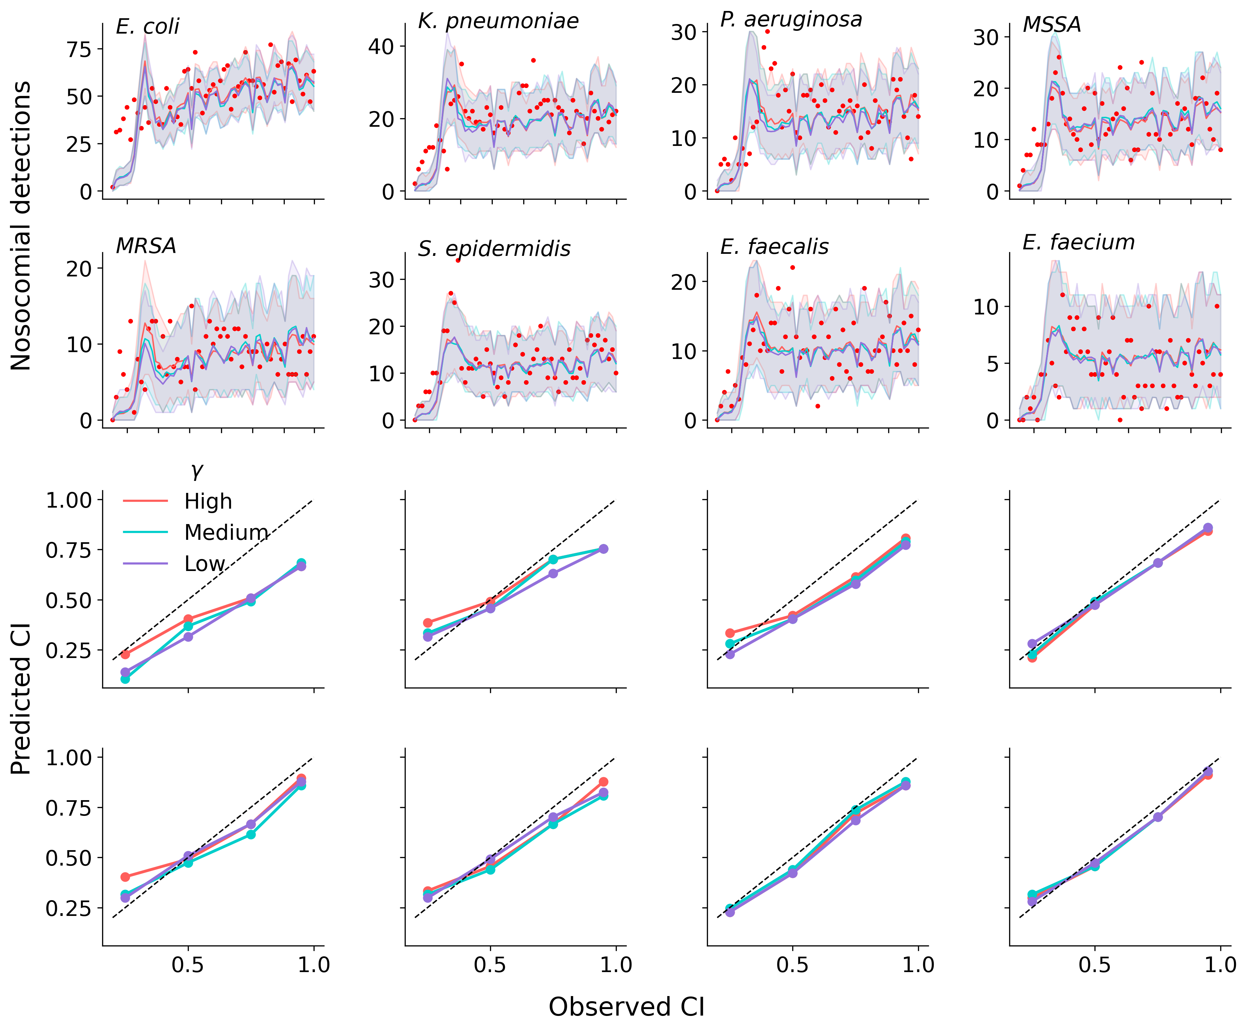
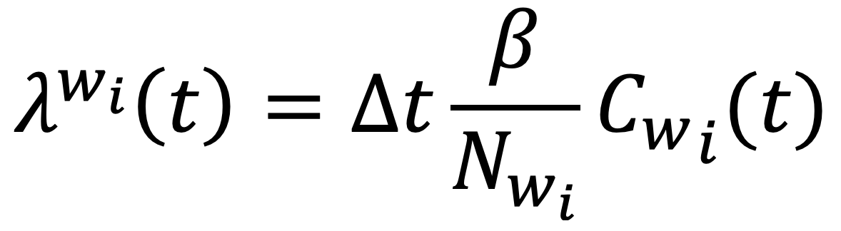
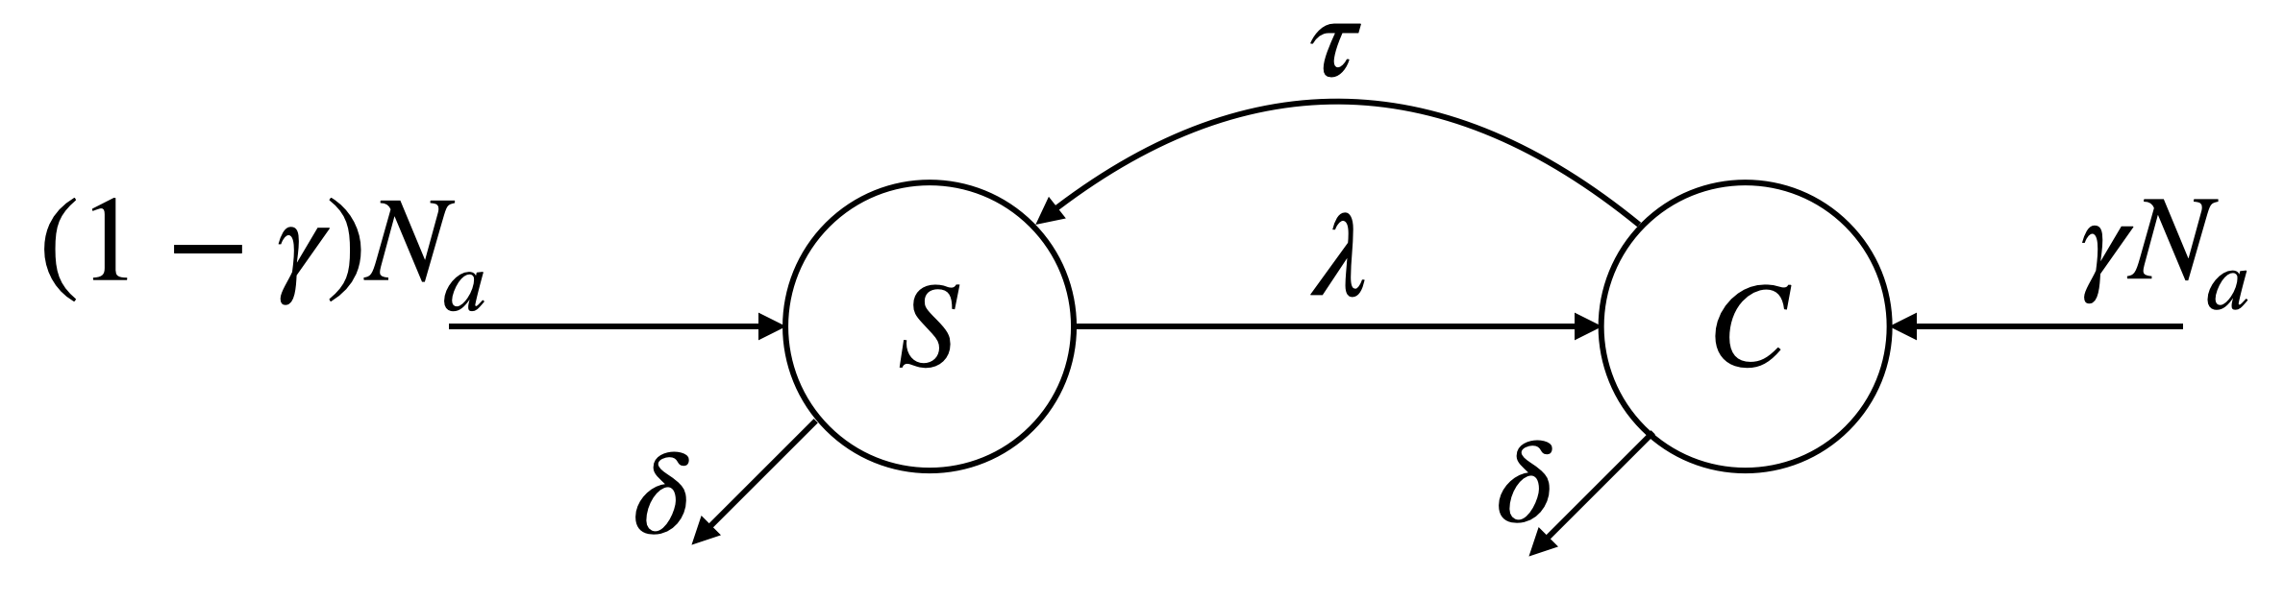

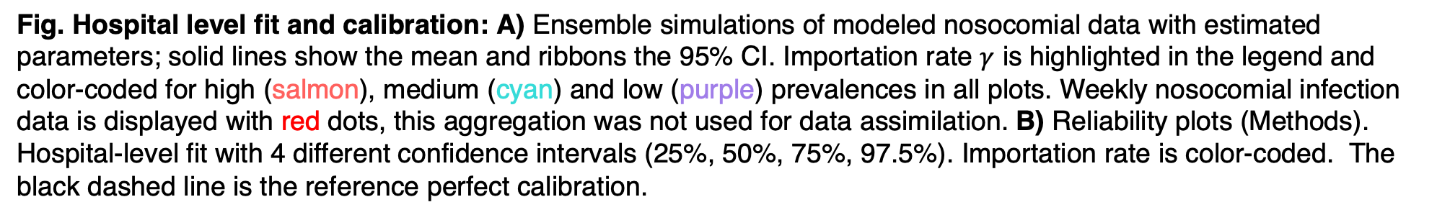
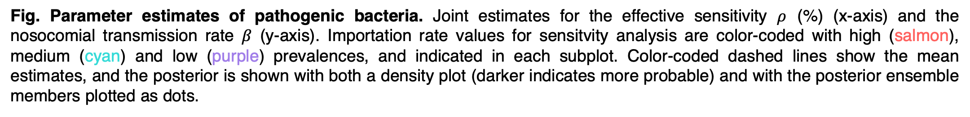
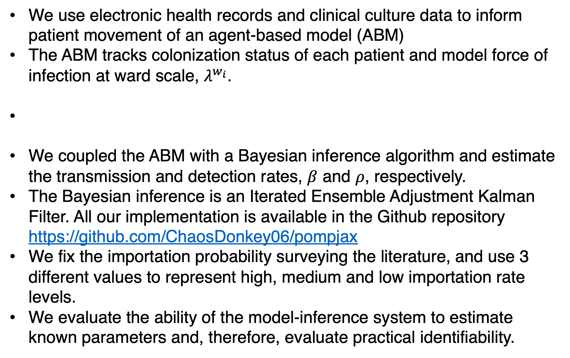
Estimating nosocomial transmission of micro-organisms in hospital settings using patient records and culture data
Jaime Cascante-Vega¹, Rami Yaari¹, Tal Robin¹, Lingshen Wen¹, Jason Zucker², Anne-Catrin Uhlemann² , Sen Pei¹, Jeffrey Shaman^{1,3} ¹Department of Environmental Health Sciences, Mailman School of Public Health, Columbia University ²Division of Infectious Diseases, Department of Medicine, Columbia University, College of Physicians and Surgeons ³Columbia Climate School, Columbia University
Introduction
Results
Communities of pathogenic bacteria circulate among patients, healthcare workers (HCWs), and the environment in hospital settings.
These bacteria infect patients when invading a typically sterile site and increase their length of stay, and treatment with antibiotics is hampered by the emergence of antimicrobial-resistant organisms (AMROs).
Quantifying transmission characteristics is needed to compare organisms, including antibiotic-resistant ones.
We found the estimated nosocomial transmission and detection of pathogenic bacteria in a major New York City hospital system and found patient traffic appears to determine epidemiological features.
E. coli transmission rate is negligible and transmission rate of MRSA and MSSA is different, as expected.
Materials
Our data comprises in-patient admissions and discharges, and outpatient visits to 170 ward units durinb-2020 to Feb-2021.
We compiled clinical culture data of 8 micro-organism that are potentially pathogenic.
Admission, discharges and clinical cultures were heterogeneous across the hospital network during the study period (Fig below)
Research Questions
Methods
Fig. Parameter estimates of pathogenic bacteria. Joint estimates for the effective sensitivity $ρ$ (%) (x-axis) and the nosocomial transmission rate $β$ (y-axis). Importation rate values for sensitvity analysis are color-coded with high (salmon), medium (cyan) and low (purple) prevalences, and indicated in each subplot. Color-coded dashed lines show the mean estimates, and the posterior is shown with both a density plot (darker indicates more probable) and with the posterior ensemble members plotted as dots.
We asses the fit at the hospital level and found the estimated parameters consistently capture the observed clinical cultures
Fig. Data: empirical colonization of microbial organisms, hospital admissions and number of clinical cultures. Upper panel. Nosocomial infection data for pathogenic bacteria studied by building; faded dots are the weekly incident detections, and solid lines are 4-weekly rolling average incident detections. Buildings are color-coded: Hospital C (purple), Hospital A (red), Hospital E (cyan), Hospital B (orange), Hospital D (green), and a fictitious unit Rest (gray). From left to right and upper to lower plots: E. coli, K. pneumoniae, P. aeruginosa, MSSA, MRSA, S. epidermidis, E. faecalis and E. faecium. Lower left. Numbers of hospitalized (green), admitted patients (salmon) and discharged patients (blue) during the study period at daily and weekly resolution, continuous faded and solid lines respectively. Admissions include both inpatient admissions and outpatient visits. Lower right. Numbers of hospitalized patients normalized by ward size (average occupancy per day during the study period); red lines show the 5 most populated wards, blue lines the 5 least populated, and the remaining wards are shown in gray in the background. We remove wards with size equal to 1 for better visualization.
Methods
Discussion
We use electronic health records and clinical culture data to inform patient movement of an agent-based model (ABM)
The ABM tracks colonization status of each patient and model force of infection at ward scale, $λ^{w_{i}}$.
We coupled the ABM with a Bayesian inference algorithm and estimate the transmission and detection rates, $β$ and $ρ$, respectively.
The Bayesian inference is an Iterated Ensemble Adjustment Kalman Filter. All our implementation is available in the Github repository https://github.com/ChaosDonkey06/pompjax
We fix the importation probability surveying the literature, and use 3 different values to represent high, medium and low importation rate levels.
We evaluate the ability of the model-inference system to estimate known parameters and, therefore, evaluate practical identifiability.
Fig. Hospital level fit and calibration: A) Ensemble simulations of modeled nosocomial data with estimated parameters; solid lines show the mean and ribbons the 95% CI. Importation rate $γ$ is highlighted in the legend and color-coded for high (salmon), medium (cyan) and low (purple) prevalences in all plots. Weekly nosocomial infection data is displayed with red dots, this aggregation was not used for data assimilation. B) Reliability plots (Methods). Hospital-level fit with 4 different confidence intervals (25%, 50%, 75%, 97.5%). Importation rate is color-coded. The black dashed line is the reference perfect calibration.
Discussion
We show that fine level patient data can support simulation-based inference of epidemiological parameters.
We show patient traffic appears to determine epidemiological quantities.
Our parameters estimates suggest resistant-susceptible to antibiotics phenotypes have different transmission rate.
Model diagram

